Slide 1
Bumps and Potholes detection
Submitted in the partial fulfillment for the award of the degree of
BACHELOR OF ENGINEERING
IN
COMPUTER SCIENCE WITH SPECIALIZATION
IN ARTIFICIAL INTELLIGENCE AND MACHINE LEARNING
Submitted by:
Mohit Choudhary:21BCS10085
Shyam Prakash Mishra: 20BCS6893
Bharat Yadav: 20BCS6901
Under the Supervision of:
Ms. Monika Singh
Department of AIT-CSE
DISCOVER . LEARN . EMPOWER

Slide 2

Outline
Introduction to Project
Problem Formulation
Objectives of the work
Methodology used
Experimental Setup
Conclusion
Future Scope

Slide 3
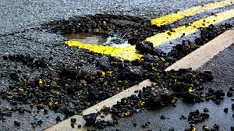
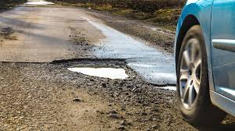
Introduction to Project
The "Bumps and Potholes Detection using AIML" project employs advanced AI algorithms to swiftly identify and classify road surface irregularities.
This innovative initiative not only ensures a more comfortable driving experience but also facilitates smarter, data-driven decisions for sustainable infrastructure development.
By harnessing the power of AIML, the project minimizes the economic impact of road damage through timely intervention, ultimately promoting efficient and cost-effective infrastructure maintenance.
Utilizing real-time data from cameras and sensors, the system enables proactive maintenance measures, contributing to enhanced road safety.

Slide 4
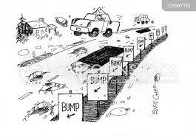
Problem Formulation
The prevalence of uneven road surfaces, characterized by bumps and potholes, poses a significant risk to both vehicle operators and pedestrians. Traditional methods of manual inspection and reactive maintenance have proven to be inefficient and costly. This project seeks to revolutionize the approach by harnessing the capabilities of Artificial Intelligence and Machine Learning. The primary goal is to develop a robust system capable of autonomously detecting and classifying road anomalies in real-time, allowing for swift and proactive interventions. By addressing this critical issue, the project aims to enhance overall transportation safety, reduce accidents caused by poor road conditions, and optimize maintenance efforts for a more sustainable and resilient urban infrastructure.

Slide 5

Objectives of the Work
Develop an easy-to-use interface for authorities to access detailed reports on road conditions, anomalies, and maintenance interventions, promoting transparency and informed decision-making.
Create a system that can instantly spot bumps and potholes on roads using AI, ensuring quick responsiveness to potential safety hazards.
Use collected data to predict future maintenance needs, optimizing resource allocation and reducing long-term infrastructure maintenance costs.
Continuously refine AI algorithms to minimize errors, making the detection system highly reliable and precise.

Slide 6
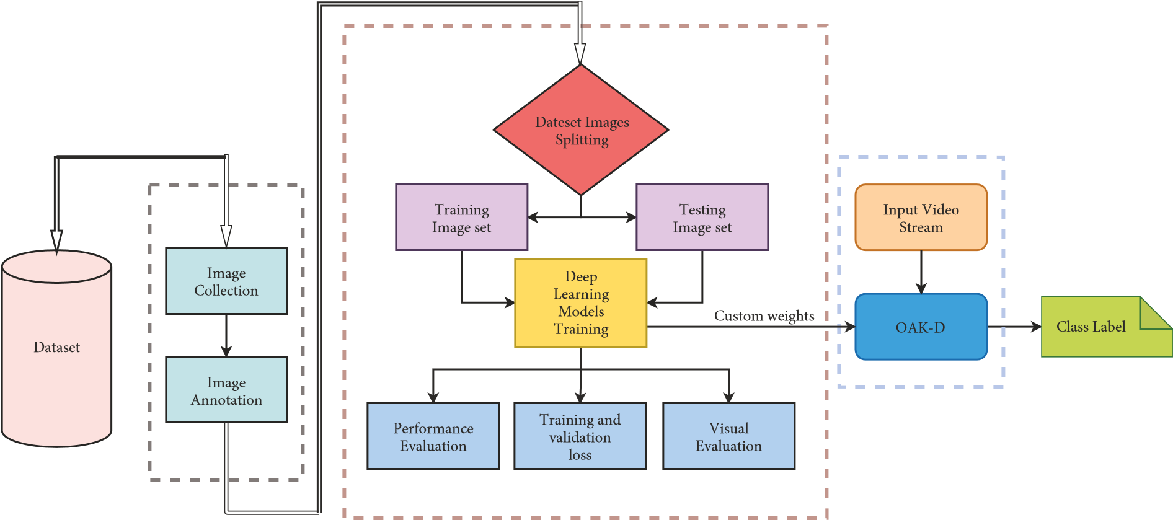
Methodology used

Slide 7
EXPERIMENTAL SETUP:
Hardware Specifications:
LAPTOP or PC with GPU and more than or equal to 4 cores.
POWER PLUG for continuous supply
RAM: 4GB or more
Peripherals: Keyboard or Mouse
Software Specifications:
Python
Jupyter Notebook or PyCharm
Tools Required:
Open CV ,Text Analysis
NumPy
Matplotlib

Slide 8

Conclusion
In conclusion, the "Bumps and Potholes Detection using AIML" project represents a significant stride towards enhancing road safety and infrastructure maintenance. By harnessing the power of Artificial Intelligence and Machine Learning, the system achieves real-time detection and classification of road anomalies, providing a proactive approach to addressing safety hazards. The continuous refinement of algorithms ensures high accuracy, minimizing errors in anomaly identification. The seamless integration with sensor networks facilitates comprehensive data analysis, contributing to a holistic understanding of road conditions Through predictive analytics, the project optimizes resource allocation for maintenance, reducing long-term costs. The user-friendly interface promotes transparency and informed decision-making for authorities. In essence, this project not only addresses immediate safety concerns but also lays the foundation for smarter, data-driven urban development and sustainable transportation infrastructure.

Slide 9
Thankyou

